Slide 2

WEEKLY REPORT
WEEK 4 – ICN TRAINING
NGUYEN HAI DANG

Slide 3
What I have done this week
Review the concepts of loss functions and activation functions.
Study a few popularly used loss functions in regression and classification.
Study a few popularly used activation functions.
Learn the concept of ensemble learning.

Slide 4

I. Loss function (Cost function)
Concept
A loss function measures model performance by calculating the deviation of a model’s predictions from the correct, “ground truth” predictions.
Its value has an inverse relationship with the efficiency of a model’s evaluations. In other words, minimizing (optimizing) the loss function is equivalent to improving a model.
θ : the set of model parameters
L(θ) or J(θ): loss function

Slide 5
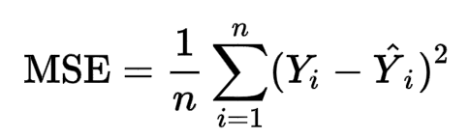
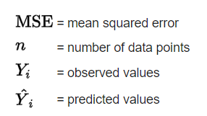
I. Loss function (Cost function)
Popular loss functions in regression
2.1. Mean squared error (MSE) / L2 loss
The average of the squared differences between the predicted value and the true value across all training examples:

Slide 6
I. Loss function (Cost function)
Popular loss functions in regression
2.1. Mean squared error (MSE) / L2 loss
Since the result is always positive, MSE solely evaluates the magnitude of error without considering its direction.
Squaring the error leads to a higher penalty to outliers in the dataset, which makes the model more precise in dealing with such instances within a dataset.
- MSE is always differentiable, making it practical for optimizing regression models through Gradient descent

Slide 7

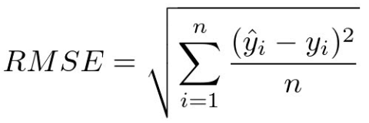
I. Loss function (Cost function)
Variations:
Mean squared logarithmic error (MSLE) is used for regression problems where the target outputs involve a wide range of potential values (e.g. exponential growth). MSLE reduces the impact of large errors.
- Root mean squared error (RMSE) is similar to MSE but is easier to interpret since it expresses the loss in the same units as the output values. (although the computational cost is higher)

Slide 8
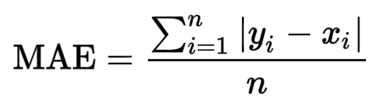
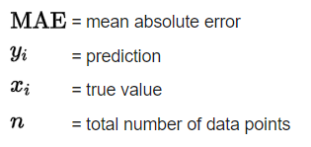
I. Loss function (Cost function)
Popular loss functions in regression
2.2. Mean absolute error (MAE) / L1 loss
The average absolute difference between the predicted value and the true value across all training examples:

Slide 9
I. Loss function (Cost function)
Popular loss functions in regression
2.2. Mean absolute error (MAE) / L1 loss
Since MAE doesn’t square each loss value like MSE, it is more robust to outliers. Hence, it is ideal in dealing with data containing extreme values that doesn’t overly impact the model
MAE penalizes small errors more than MSE
- MAE is not differentiable if the predicted output matches the actual output (i.e. loss = 0)

Slide 10
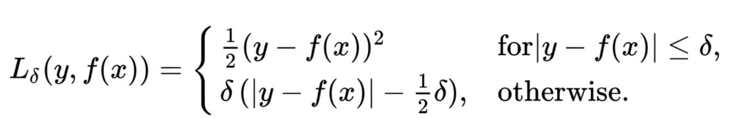
I. Loss function (Cost function)
Popular loss functions in regression
2.3. Huber loss / Smooth MAE
A hybrid combination of MSE and MAE into a single loss function.
Here, δ (delta) is a hyperparameter that acts a transition point: the Huber loss is quadratic for loss values below or equal to δ, and linear otherwise.
This loss function has both the advantages of MSE (differentiability) and MAE (robustness to outliers)

Slide 11
I. Loss function (Cost function)
Popular loss functions in classification
3.1. Cross-entropy
Entropy: the degree of uncertainty within a system
Cross-entropy: the difference between two probability distributions
Here, it indicates the difference between the “ground truth” distribution of probabilities and the probabilities predicted by the model.
Output: A probability value between 0 and 1
There are two types of cross-entropy loss functions.

Slide 12
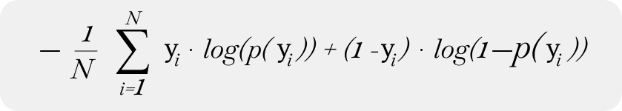
I. Loss function (Cost function)
Binary cross-entropy (Log loss): used for binary classification, logistic regression problems
y: true likelihood (either 0 or 1)
p(y): predicted likelihood (between 0 and 1)
This loss function penalizes predictions that are either inaccurate or has a low certainty, incentivizing the model to make correct and confident predictions.
The logarithm function makes the algorithm heavily penalize predictions that are confidently wrong.
The ‘-’ sign maintains the convention of “lower loss = less error”

Slide 13

I. Loss function (Cost function)
Categorical cross-entropy: used for multi-class classification, softmax regression problems
p: true probability distribution
q: predicted probability distribution
C: number of classes
The output is a probability distribution, with the values for each label collectively summing up to 1.
Minimizing this function increases the output value for the correct class and decreases such values for incorrect classes, thus bringing the distribution closer to the “ground truth”.

Slide 14
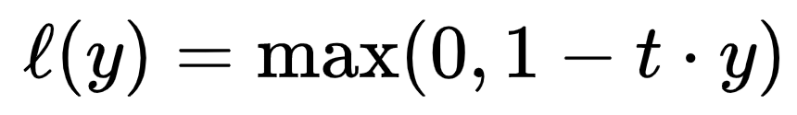
I. Loss function (Cost function)
Popular loss functions in classification
3.2. Hinge loss
Well-suited for binary classification problems and for optimizing support vector machine (SVM) models.
Effective for optimizing a decision boundary for separating two classes.
t: true label (-1 or 1)
y: classifier output
The outcome is always non-negative. If 1-t.y is negative i.e. t and y are the same sign (correct class prediction), the loss is defined as 0

Slide 15

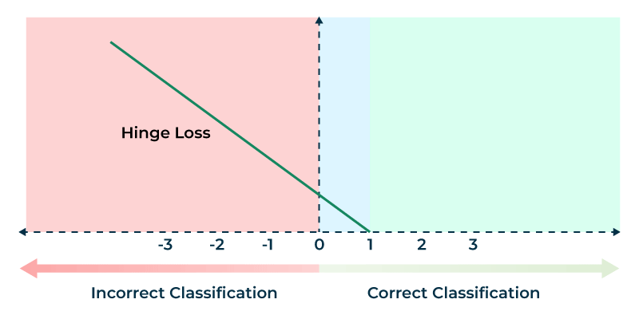


Slide 16

II. Activation function
Concept
An activation function transforms the input signal of a node into an output signal in a neural network.
Activation functions introduce non-linearities, allowing neural networks to learn highly complex mappings between inputs and outputs rather than just linear relationships.
f^{(l)}(.): a non-linear activation function

Slide 17
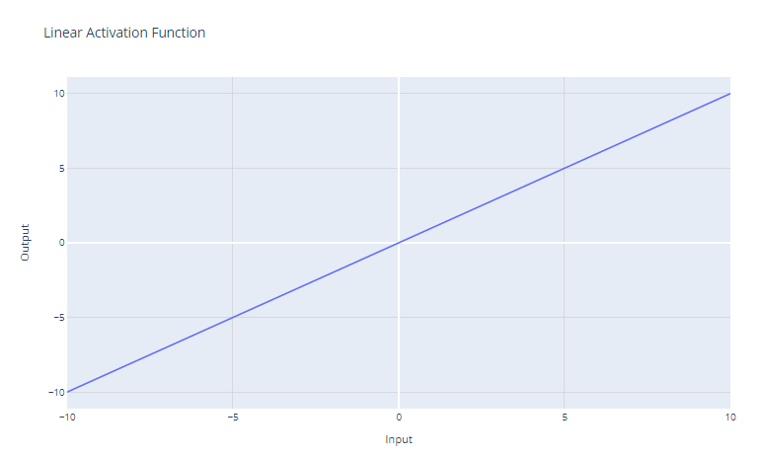
II. Activation function
Common activation functions
2.1. Linear activation
The simplest activation function:
f(x) = x
Mostly used for the output layer
of a neural network in regression,
since we want to predict a numerical
value.
- Not used for hidden layers, as it doesn’t provide non-linearity.

Slide 18
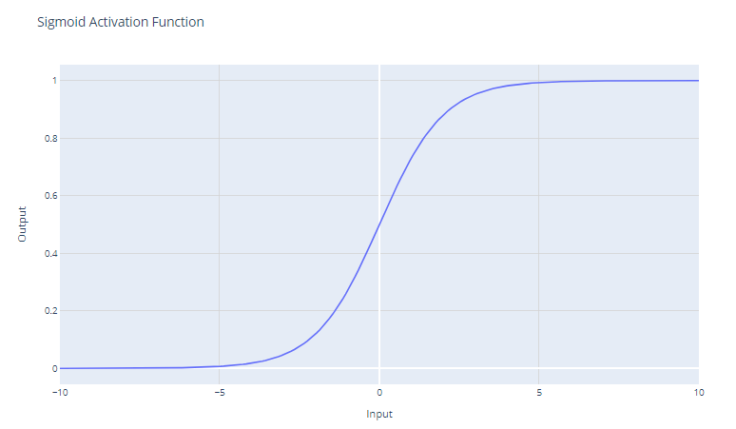
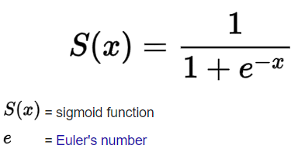
II. Activation function
Common activation functions
2.2. Sigmoid activation
A smooth, continuously differen
-tiable function:
The output is a value between 0 and 1.
It is mainly used for binary classification models

Slide 19
II. Activation function
Common activation functions
2.2. Sigmoid activation
In early neural networks, this function was
common since the gradient is strongest as the
output nears 0.5 (allowing for efficient backpropagation)
However, as the output nears 1 or 0, the gradient is close to 0,
resulting in very minor changes in weights in backpropagation
-> Slows down or even halts the learning process of models (the “vanishing gradient” problem)

Slide 20
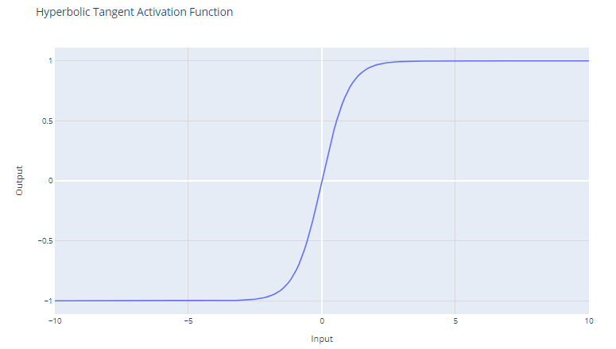
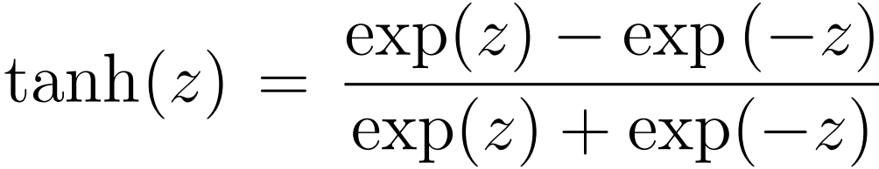
II. Activation function
Common activation functions
2.3. Tanh (hyperbolic tangent)
More effective than sigmoid in
dealing with negative values, since
it is zero-centered:
Since the output ranges between -1 and +1, the function has stronger gradients, resulting in faster learning and convergence during training.

Slide 21
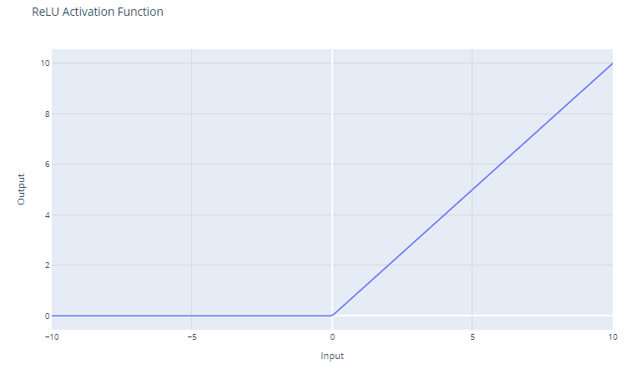
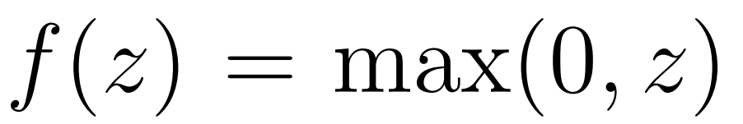
II. Activation function
Common activation functions
2.4. ReLU (rectified linear unit)
This function’s seen common use
of late thanks to its simplicity:
Since ReLU returns a gradient of 1 for inputs greater than 0, it allows the gradient to pass through unchanged during backpropagation, thereby mitigating the vanishing gradient problem.
It also greatly reduces computational burden in scaling layers.

Slide 22
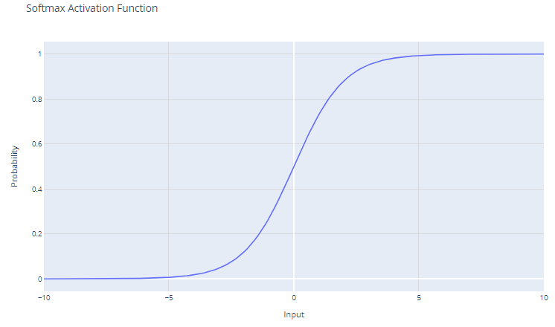

II. Activation function
Common activation functions
2.5. Softmax function
Useful in multi-class classification
problems:
where z is the input vector with elements z₁, z₂, z₃,…
- The output of the softmax function is a probability distribution that sums up to 1.

Slide 23
II. Activation function
Common activation functions
2.5. Softmax function
Thanks to exponentiation:
The softmax function amplifies differences in the input vector.
Output values are non-negative (crucial in expressing probabilities)
However, it can be sensitive to outliers or extreme values, leading to an overconfident model.

Slide 24
III. Ensemble learning
Concept
- Combining two or more learners (e.g. regression models, neural networks) in order to produce better predictions.
- We employ this technique to yield an overall lower error rate while retaining each individual model’s own complexities and advantages such as low bias or low variance.
In this sense, combining such models would altogether improve the accuracy of a model by reducing bias or variance.
- Ensemble learning can also serve as an alternative to dimensionality reduction as it can help resolve issues stemming from high-dimensional data.

Slide 25
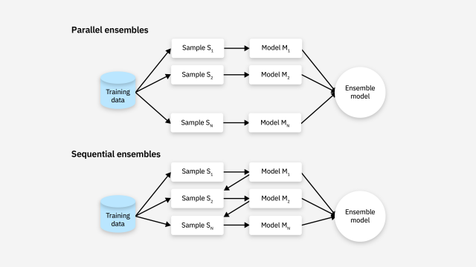
III. Ensemble learning
Types of ensemble models
Parallel: independent
training, apart from
the others
Sequential: the next
model minimizes
errors made by
the previous

Slide 26
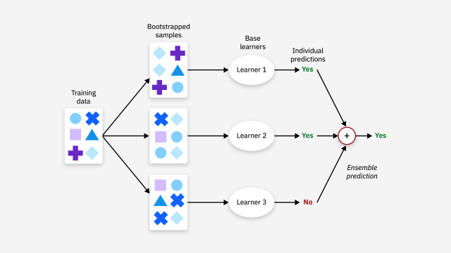
III. Ensemble learning
Ensemble learning techniques
Bagging: Constructing a large number of same-type models on different subsamples from the training dataset – training them independently and simultaneously - combining the results from each for a final output
- Bagging focuses on reducing variance
Prime example: Random forests use ensembles of decision trees

Slide 27
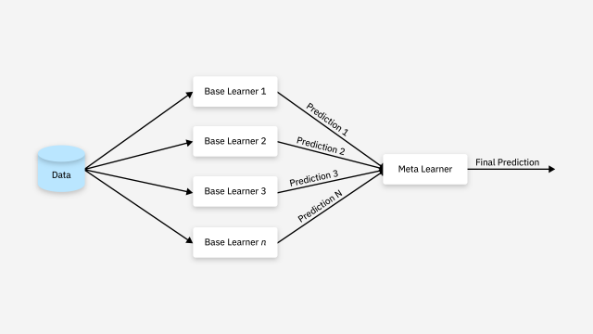
III. Ensemble learning
Ensemble learning techniques
Stacking: Constructing a few different types of models and a meta (supervisor) model. Train base models separately and let the meta model combine the previous predictions into the final result
- Stacking can help reduce both bias and variance

Slide 28
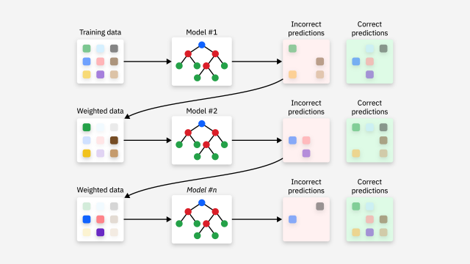
III. Ensemble learning
Ensemble learning techniques
Boosting: Constructing a large number of models, the next one correcting errors from the previous, creating a chain of sequentially better models. The final result is obtained from the output of the last model trained.
Boosting can help reduce both bias and variance

Slide 29
THANK YOU !

